Slide 1
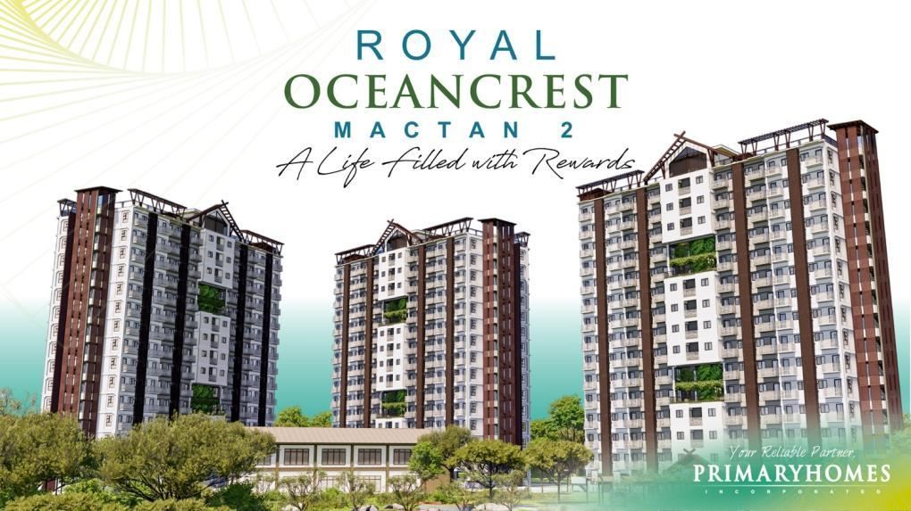
Artist’s Perspective
LS NO. 0002210

Slide 2
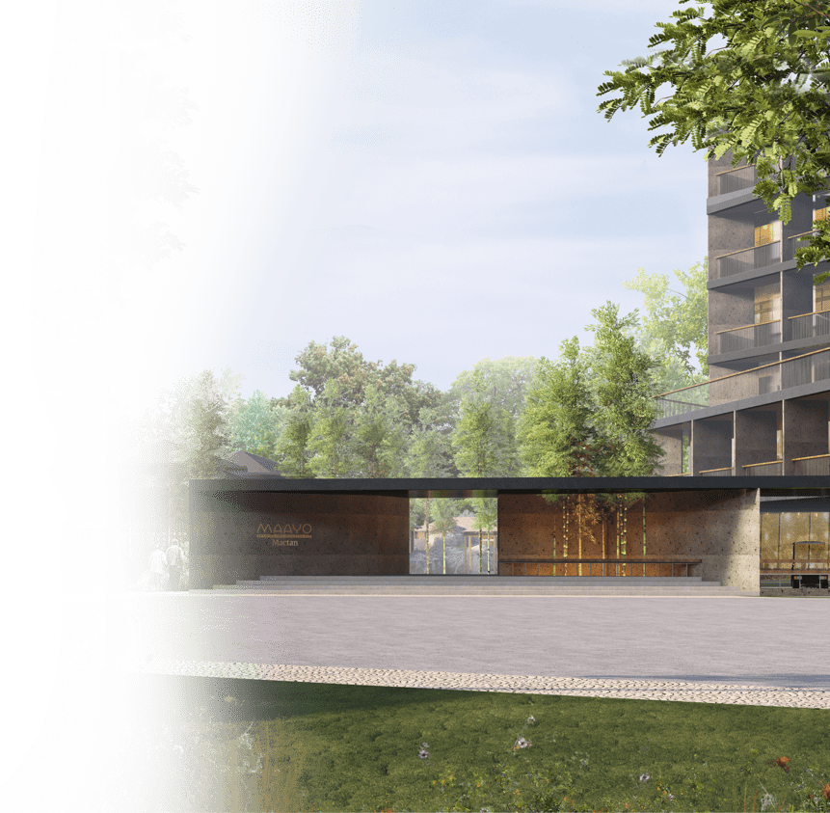




Conceptual Design
Discover a life filled with rewards with Royal Oceancrest.
The Rewards of a Resort-like Getaway
The Rewards of an Enriching Gateway
The Rewards of a Business Opportunity
A vacation home that ripples out the financial security you need, the escape you crave, and the peace of mind you’ve been longing for.
Artist’s Perspective

Slide 3
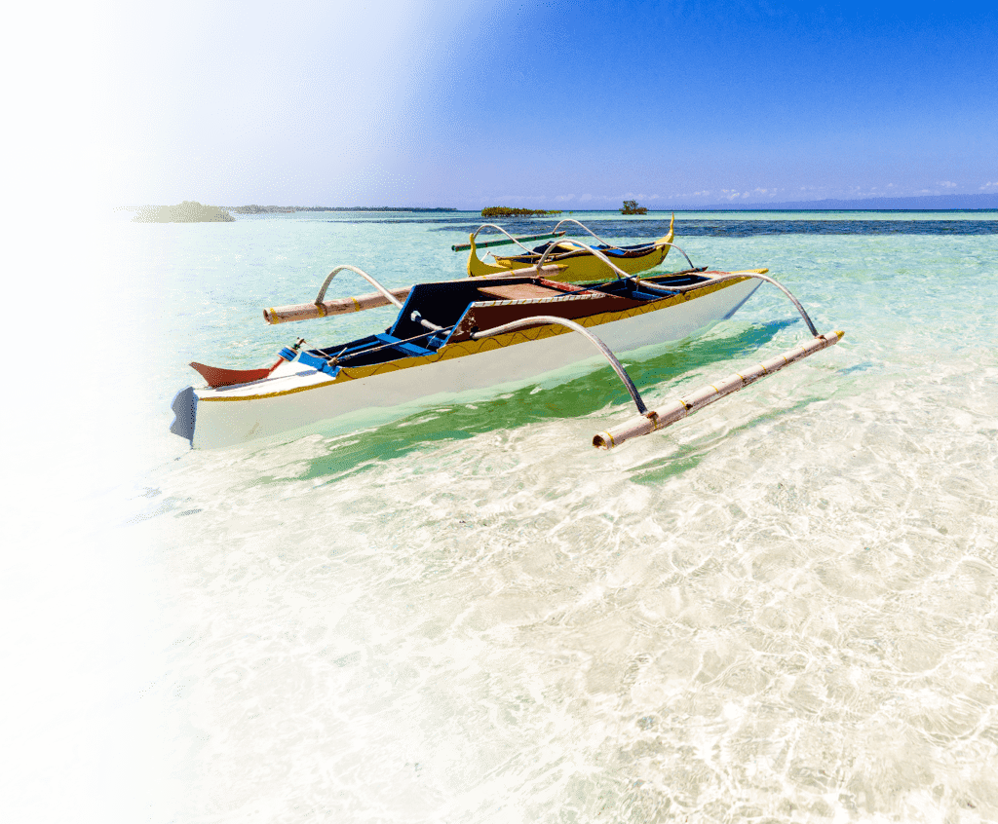
MACTAN ISLAND, CEBU
With its proximity to main tourist attractions, commercial developments, and transportation - your unit will surely become a booking magnet.

Slide 4
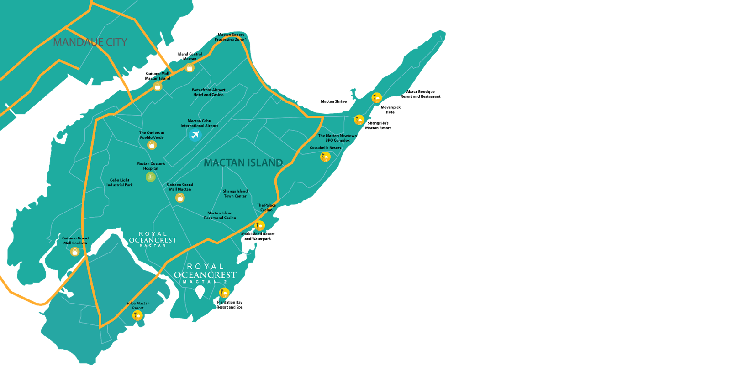
Uncover the rewards of an enriching gateway with Mactan's world-class beaches and unparalleled accessibility.
600 m ------------------------------------------------- Beach Resorts
2.9 km ---------------------------- Allegiant Regional Care Hospital
3.7 km ------------------------------------------- Gaisano Grand Basak
5.2 km -------------------------------------- Cebu Light Industrial Park
5.9 km ---------------------------- The Outlets Mall at Pueblo Verde
7.0 km -------------------- Lapu Lapu - Cebu International College
11.1 km ----------------------- Mactan-Cebu International Airport

Slide 5
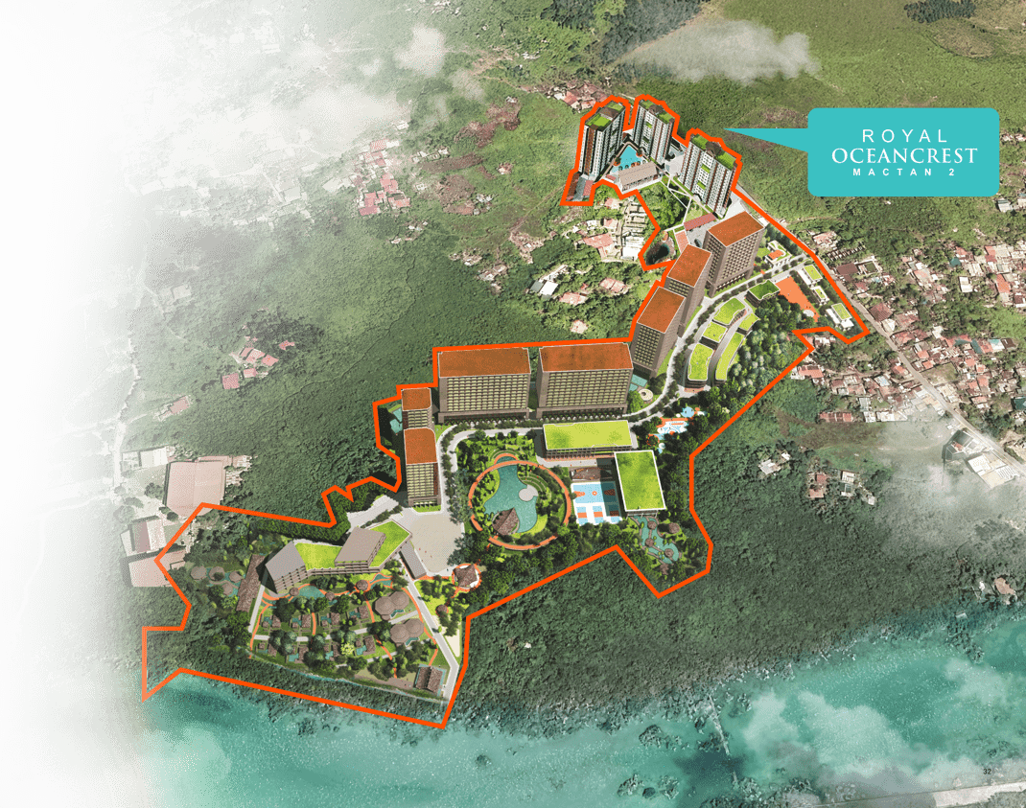
Conceptual Design
NESTLED IN A FUTURE TOWNSHIP DEVELOPMENT

Slide 6
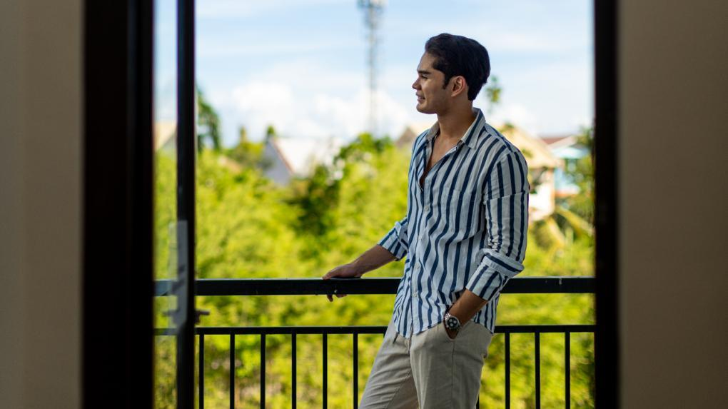

THE REWARDS OF A
BUSINESS OPPORTUNITY

Slide 7



WHY IS IT PROFITABLE
IDEAL VACATION RENTAL PROPERTY:
  ✓ Getaway that pays
  ✓ Passive income generating
3,500 php
50,000 php
*estimated rates in 2030
  ✓ High resale value

Slide 8



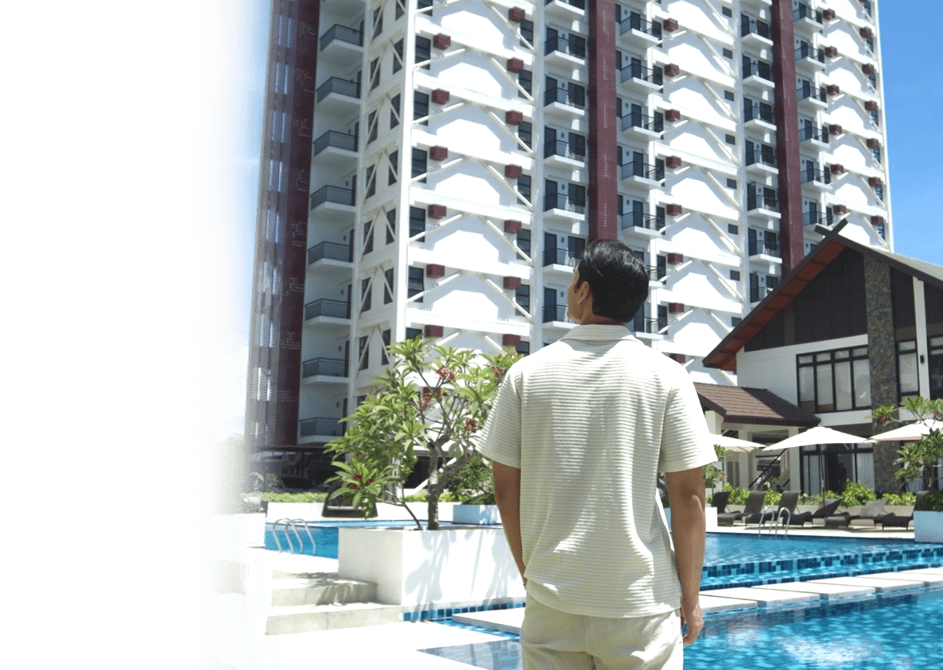

THE REAL VALUE
OF QUALITY
  ✓ Over 30 years in property development
  ✓ 55 developments with 17,000 units delivered on-time
  ✓ Best Sustainable Developer
  & Sustainable Construction Awardee

Slide 9




Advantage
As part of a fully integrated shelter solutions provider the Primary Group of Builders, PrimaryHomes has access to a complete range of construction and development expertise—ensuring every project is built to last.
AAA category General Contractor
70 years in the industry
Durabie, eco-friendly, and cost-efficient
materials and methods
Superior quality ready-mix and
prefabricated concrete

Slide 10
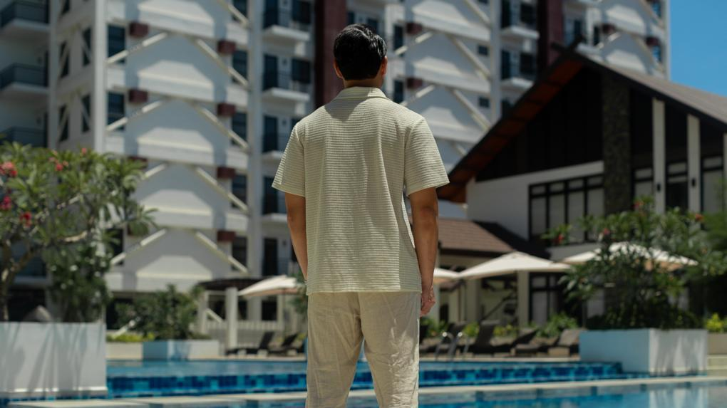
THE REWARDS OF A
RESORT-LIKE GETAWAY

Slide 11

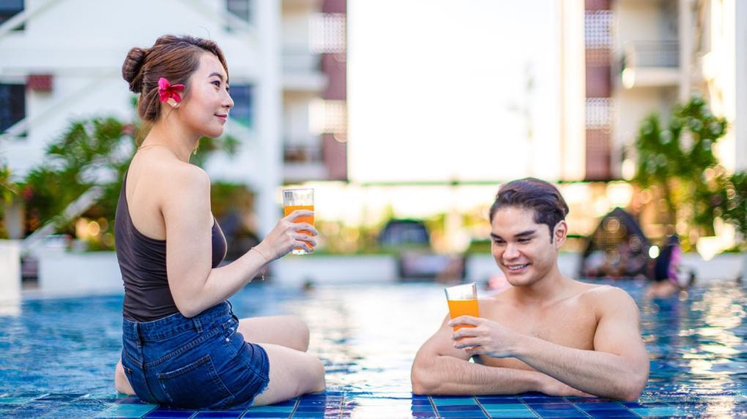
Savor the getaway of your dreams with impressive amenities and features.

Slide 12
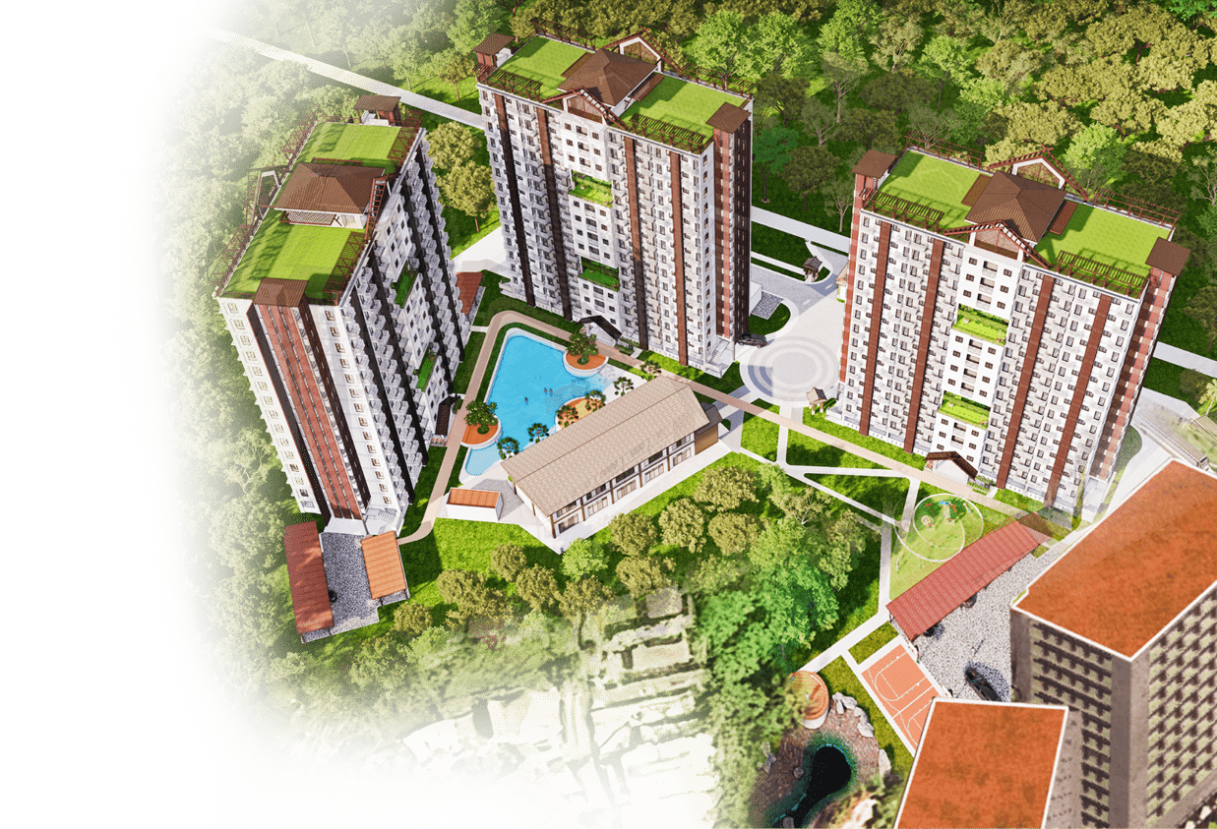
Artist’s Perspective
DESIGNED TO BE
BREATHTAKING
A 1.2-hectare resort-style property featuring 72% of open spaces-and offering 702 superb finished units.

Slide 13
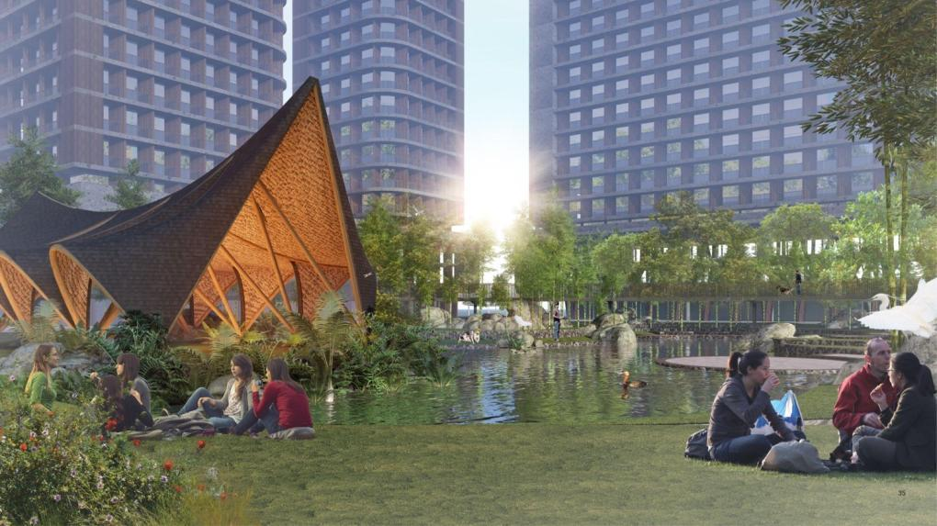
Conceptual Design
A New Vision of Modern Township Living

Slide 14

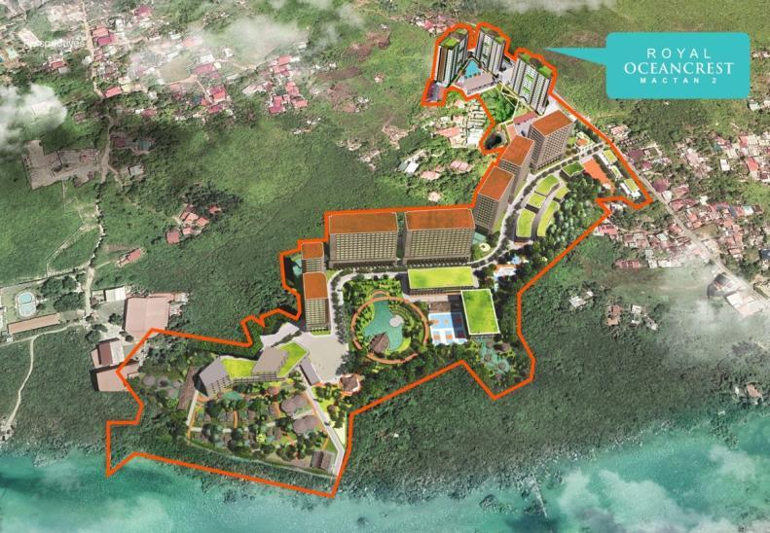

Conceptual Design
Live, Work, Play, And Thrive - Where Nature Complements Modern Lifestyle
Commercial Area
Residential Towers
Resort

Slide 15
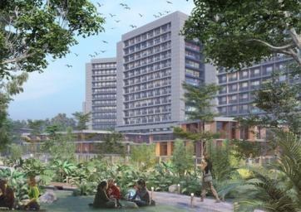
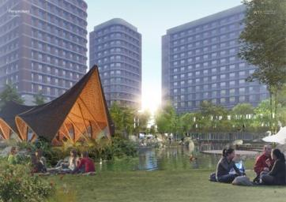
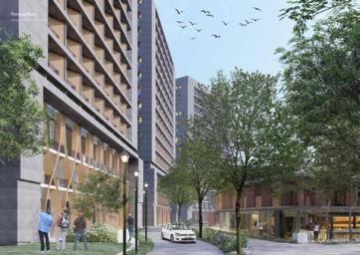
Conceptual Design
Live, Work, Play, And Thrive - Where Nature Complements Modern Lifestyle

Slide 16
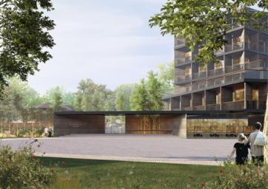
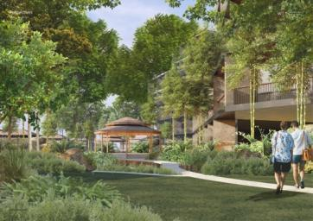
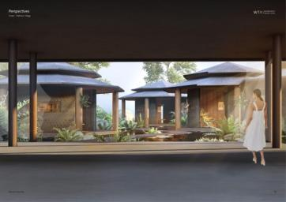
Conceptual Design
Live, Work, Play, And Thrive - Where Nature Complements Modern Lifestyle

Slide 17
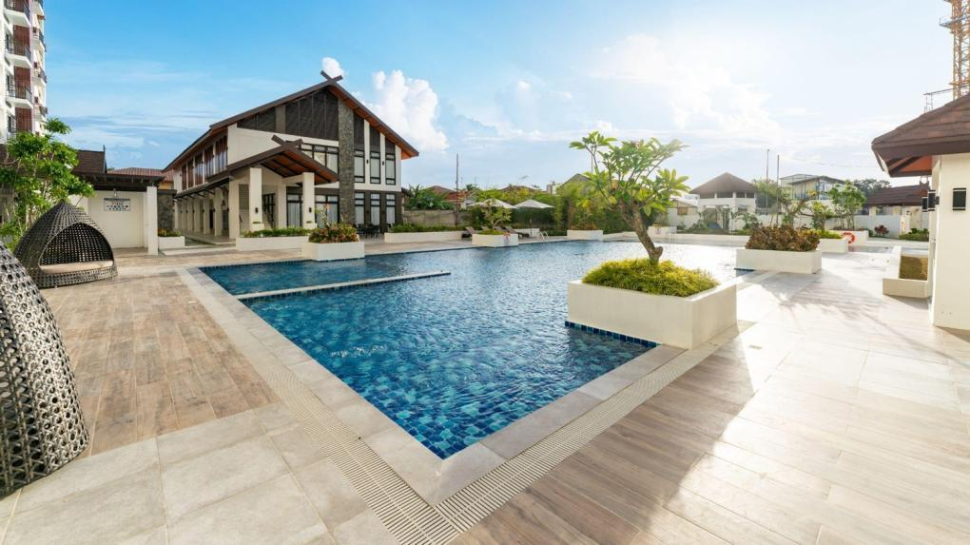
Royal Oceancrest Mactan Actual Photo
Breathtaking Vacation Rental Amenities

Slide 18
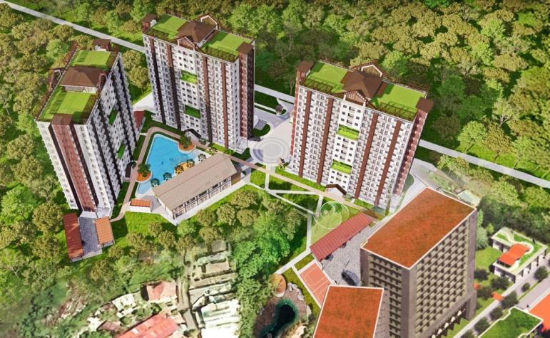
1
Guardhouse
Drop off Area
Delivery
LEISURE AMENITIES
Swimming Pool
Meditation Garden
WELLNESS ZONE
Fitness Gym
Jogging Trail
Outdoor Gym
Shooting Hoops
FUN SPACES
Children’s Playground
SOCIAL HUBS
Clubhouse
*Function Room
*Fitness Gym
Grilling Stations
COMMERCIAL AREA
Commercial Area
Garden Pods
Skydeck with 360 views
TOWER B
Artist’s Perspective
2
3
15
TOWER A
TOWER C
4
14
15
5
15
14
14
1
12
6
14
7
14
2
8
4
3
14
9
11
6
5
7
13
10
12
10
8
12
11
9
12
13
14
Disclaimer: The information provided in this document is intended for informational purposes only and should not be considered as a binding offer, representation, or warranty, whether expressed or implied, by the owner, its representatives, or agents. The developer reserves the right to modify plans, amenities, and specifications as needed for the overall development.
15

Slide 19
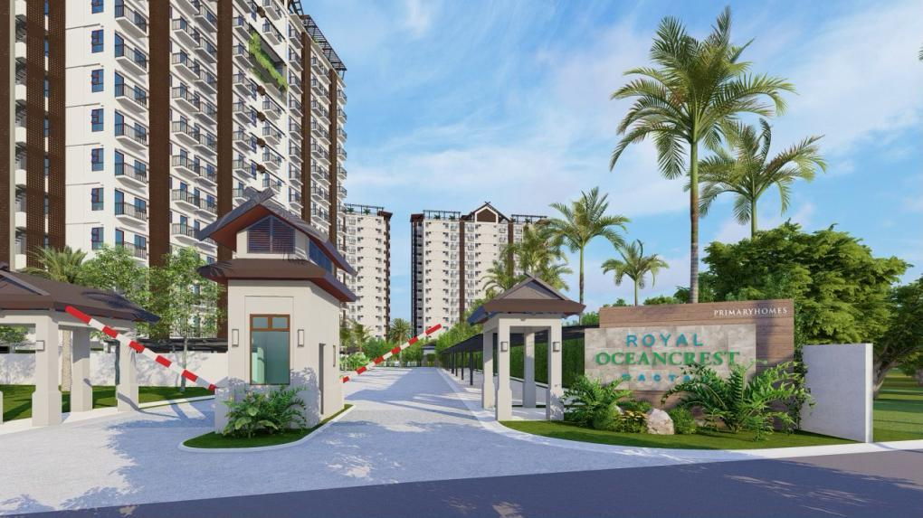

Royal Oceancrest Mactan Actual Photo
Well-composed Entrance with Guardhouse and Efficient Drop-off Point
The Rewards of a Resort-like Getaway

Slide 20

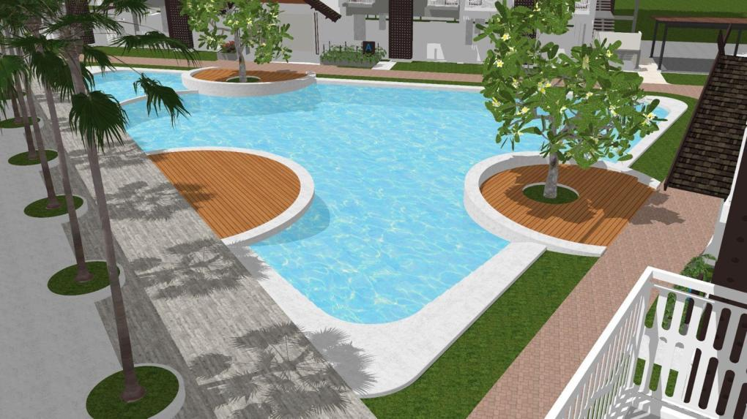
Leisure Amenities
Artist’s Perspective
Take a refreshing dip in the
Swimming Pool
The Rewards of a Resort-like Getaway

Slide 21

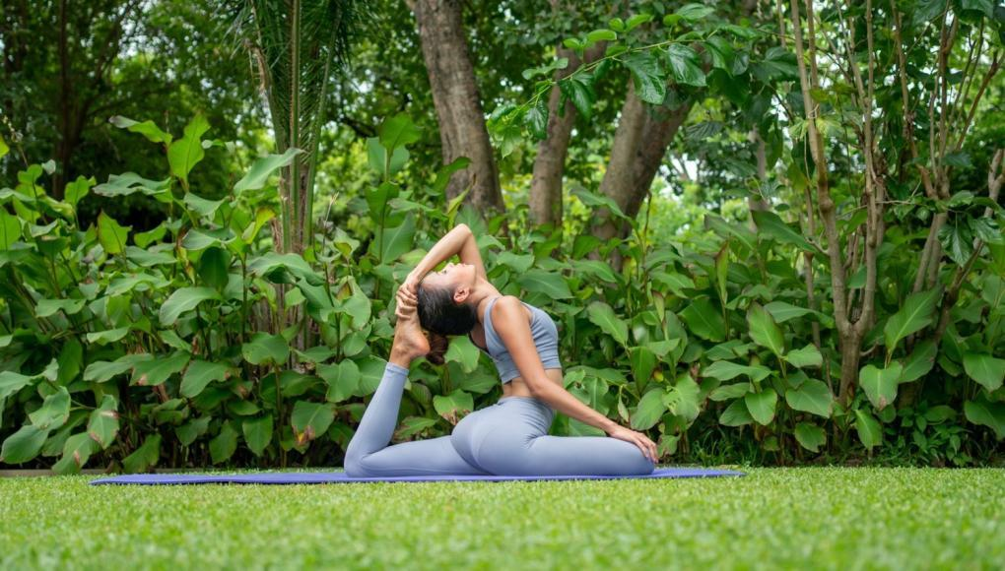
Leisure Amenities
Visual Representation
Take time to recharge at the
Landscape and Meditation Garden
The Rewards of a Resort-like Getaway

Slide 22
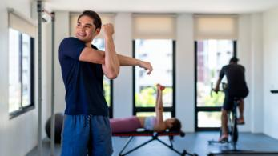
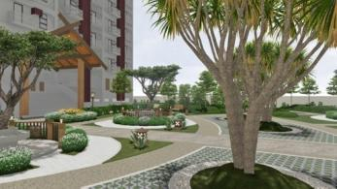
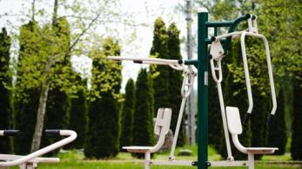

Wellness Zone
Conceptual Design
Conceptual Design
Stay fit without leaving home
Fitness Gym
Jogging Trail
Outdoor Gym
Shooting Hoops
The Rewards of a Resort-like Getaway

Slide 23
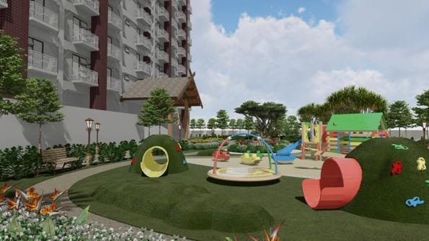
Fun Spaces
Conceptual Design
Move freely and play fully at the
Children’s Playground
The Rewards of a Resort-like Getaway

Slide 24

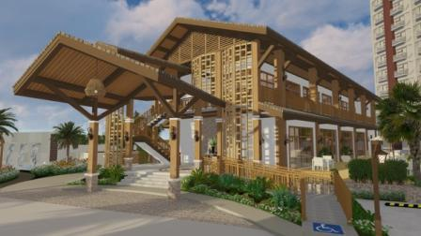

Social Hubs
Conceptual Design
Conceptual Design
Connect, celebrate, and create community
Clubhouse
Grilling Stations
The Rewards of a Resort-like Getaway

Slide 25
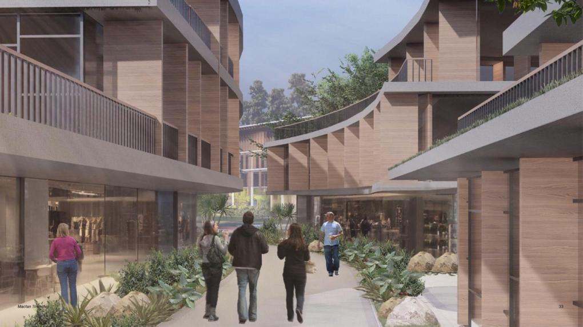
Conceptual Design
Experience everyday convenience with a range of shops and services at the
Commercial Area
The Rewards of a Resort-like Getaway

Slide 26
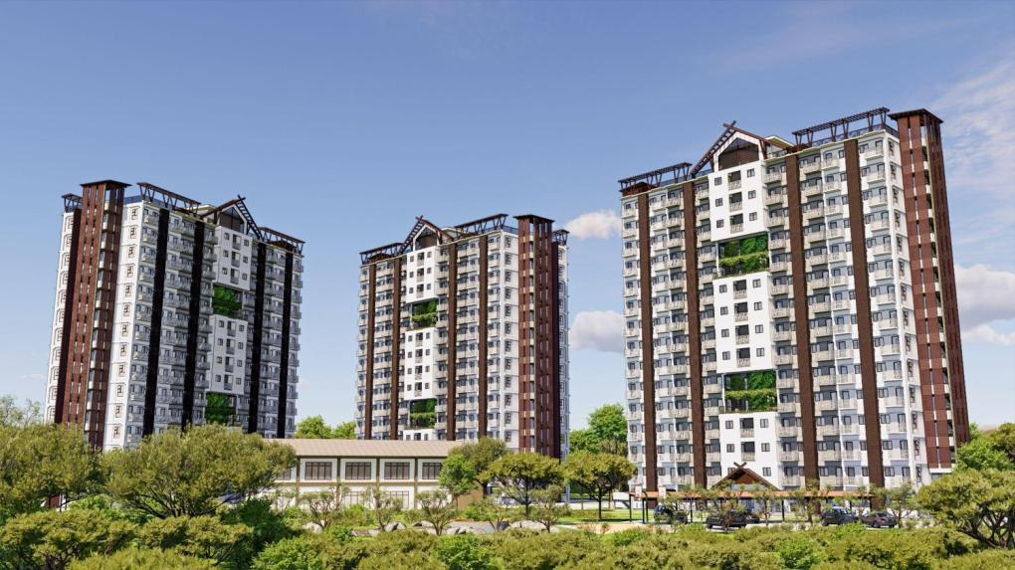
Artist’s Perspective
Thoughtfully-designed Dwelling Spaces

Slide 27
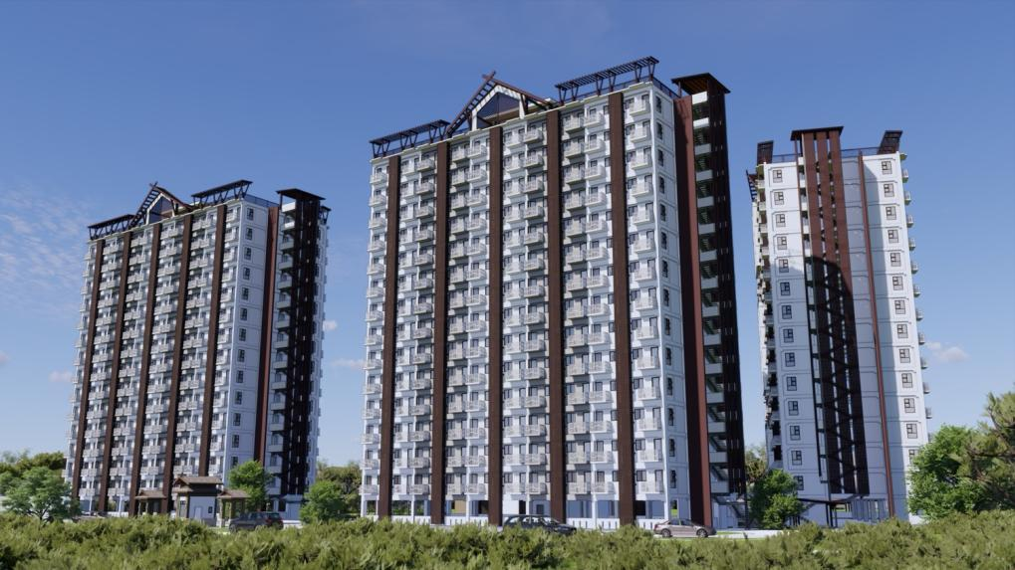
Artist’s Perspective

Slide 28
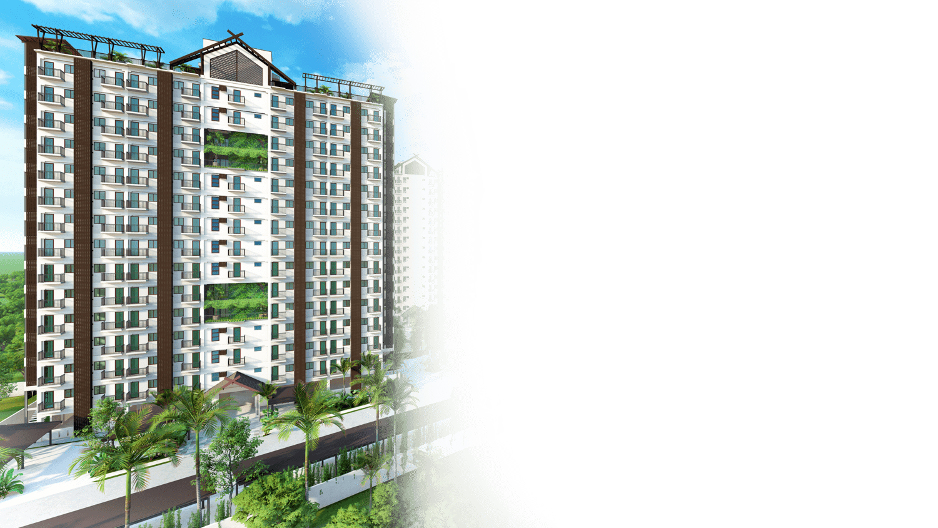
Artist’s Perspective
BUILDING FEATURES
Explore a nature-integrated design, with fluid indoor-outdoor transitions—enhanced by amenities that make everyday living effortless.
Well-spaced, low-density design for privacy and comfort
Open lobby and breezy, well-ventilated hallways
2 elevator units with elevator keycard
CCTV, fire alarm, sprinkler system, and designated fire exits for added security and safety
Standby generator set and overhead water tank ensuring uninterrupted service

Slide 29

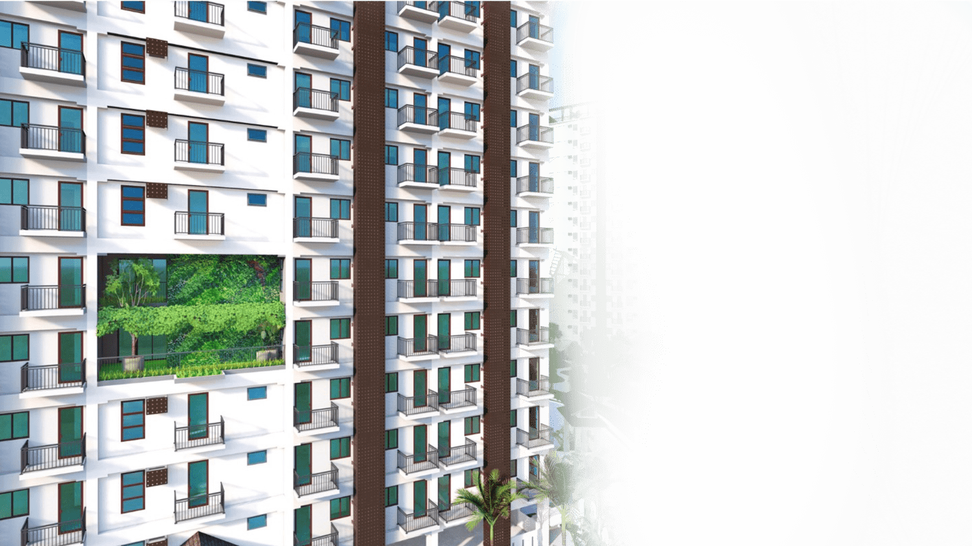

Royal Oceancrest Mactan Render
Enhance your connection to nature with the mindfully placed
Garden Pods

Slide 30
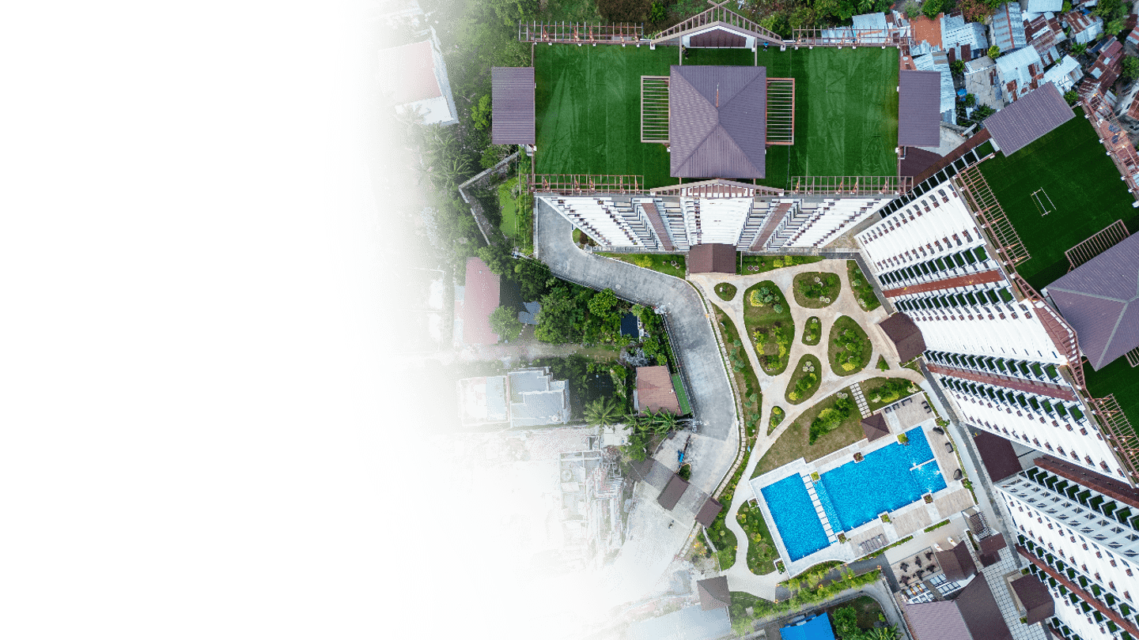
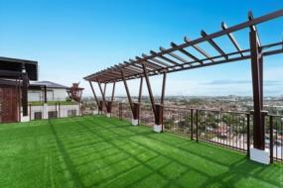
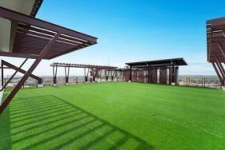
Royal Oceancrest Mactan Actual Photo
Unwind or lounge at the
Skydeck with 360 views

Slide 31
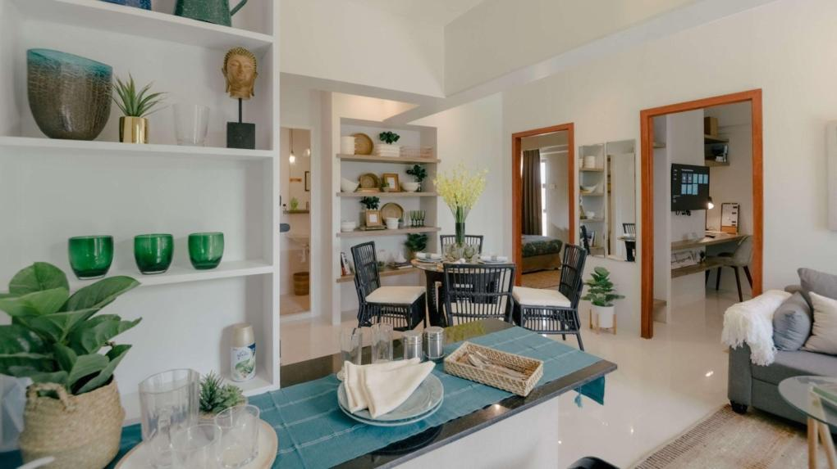
Royal Oceancrest Mactan Actual Photo
Smartly-designed Units

Slide 32
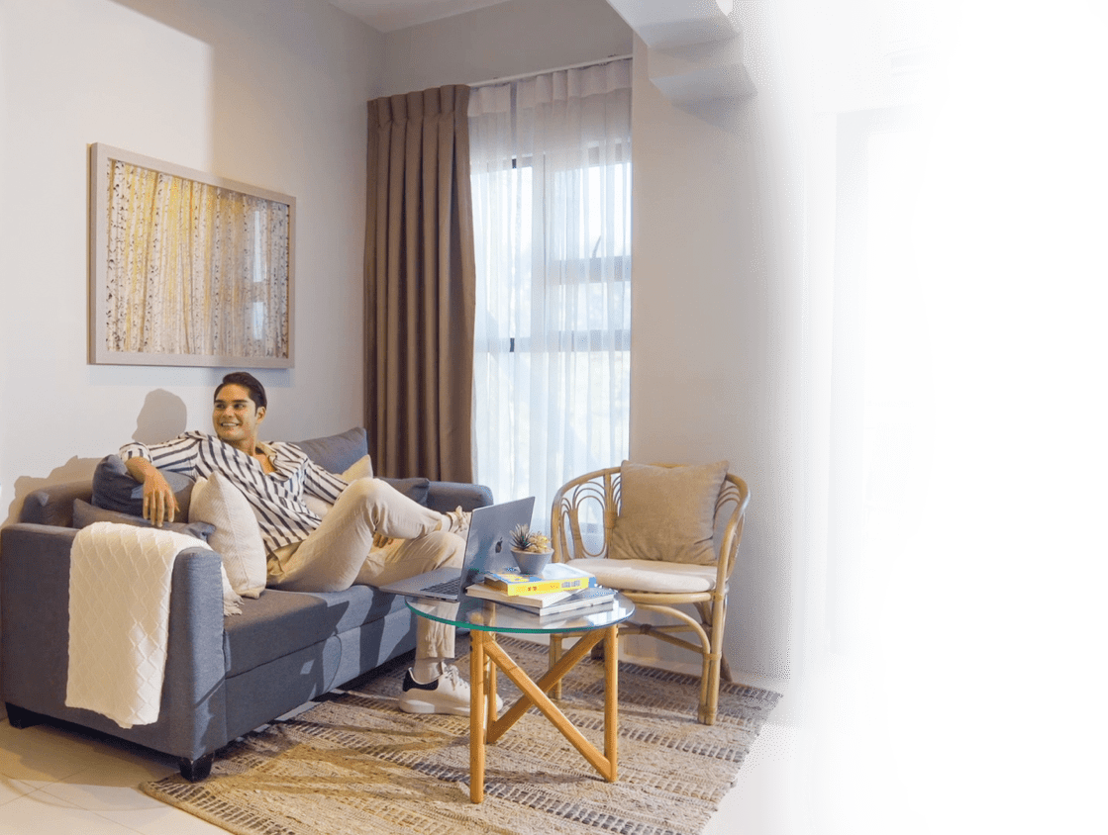
Ideal for personal use or rental
Discover a home designed for comfort and functionality, featuring fluently-blended layout creating a bright and airy living space.

Slide 33
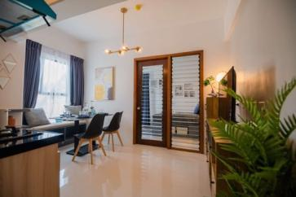
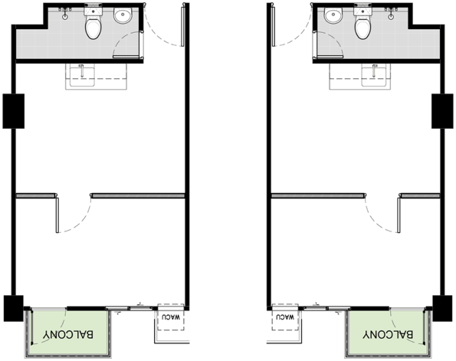
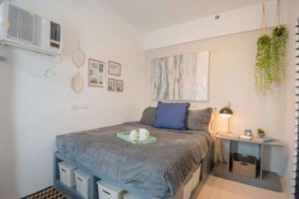
  1 Bedroom A
with Balcony | 30 sqm
Royal Oceancrest Mactan Actual Photo
Royal Oceancrest Mactan Actual Photo

Slide 34
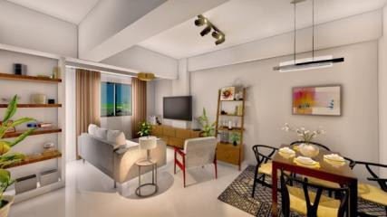
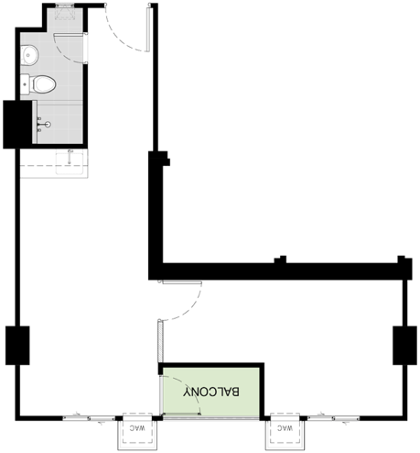
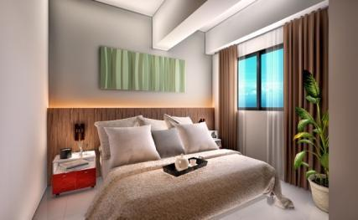
  1 Bedroom B
with Balcony | 44 sqm
Royal Oceancrest Panglao 2 Render
Royal Oceancrest Panglao 2 Render

Slide 35
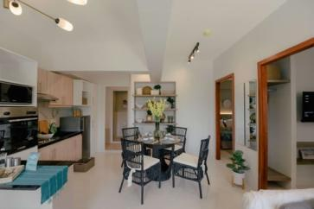
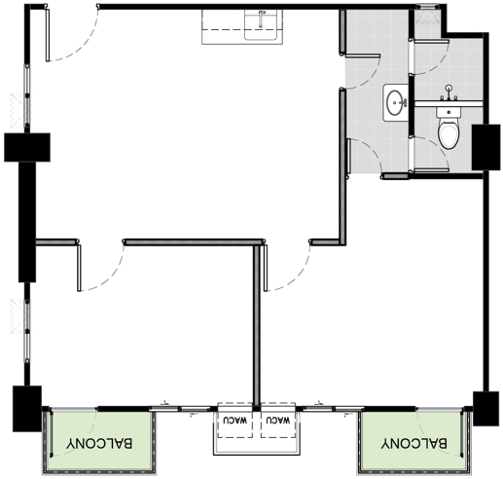
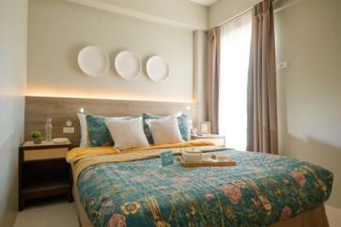
  2 Bedroom
with Balcony | 60 sqm
Royal Oceancrest Mactan Actual Photo
Royal Oceancrest Mactan Actual Photo

Slide 36
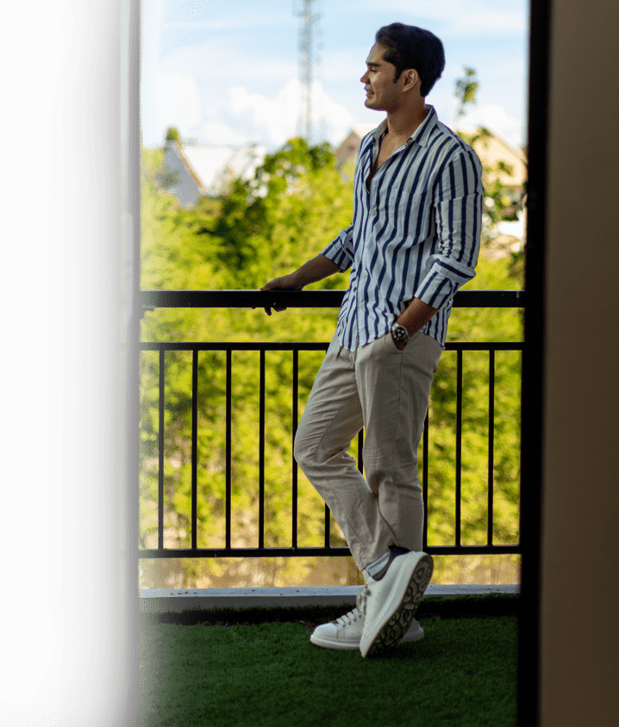
UNIT FEATURES
Have a refreshing outdoor retreat from a Private Balcony
with garden-inspired, soft turf flooring
*except for 1 Bedroom B 2nd floor

Slide 37
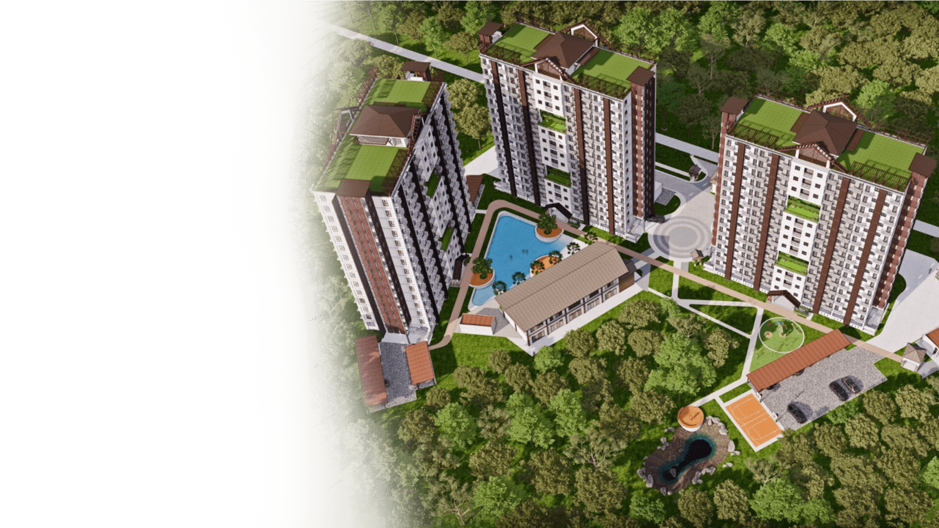
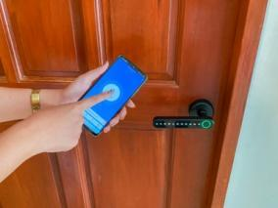
Artist’s Perspective
UNIT FEATURES
Simplify rental management process with the Smart Door lock System
Royal Oceancrest Mactan Actual Photo

Slide 38


Royal Oceancrest Mactan Actual Photo
  UNIT FEATURES
Well-finished interiors
Ample floor-to-ceiling height and excellent window ventilation.
Seamlessly connected layout for the kitchen, dining, and living areas.
Tastefully painted and tiled living, dining, bedroom, and bathroom areas.
Functional kitchen setup with countertop, sink, and cabinets.
Toilet and bath with quality fixtures.

Slide 39


Regular Floors: Floors 3, 5, 8-11, 15-17
Typical
Building Layout
15 Floors
234 units per tower
Regular Floors: 17 units
Garden Floors: 16 units
Tower A
Garden Floors: 6 -7, 12 & 14
1 Bedroom A | 30 sqm
1 Bedroom B | 44 sqm
2 Bedroom | 60 sqm
Garden Pods

Slide 40

Worthwhile Investment Opportunity

Slide 41

Ride The High-Tide Of A Worthwhile Investment Opportunity

Slide 42
Artist’s Perspective
LS NO. 0002210

